Slide 1
VLSI Digital Design using Xilinx Vivado Design Suite targeted towards FPGAs
Presented By
Binit Kumar Pandit
Ph.D. Scholar

Slide 2
FPGAs: Field Programmable Gate Array
FPGA is an integrated circuit (IC) that can be programmed in the field after manufacture.
Field programmable Gate Arrays (FPGAs) are pre-fabricated silicon devices that can be electrically programmed in the field to become almost any kind of Digital Circuit or System.
FPGA Building Blocks:
Programmable logic blocks: Implement combinatorial and sequential logic
Programmable interconnect: Wires to connect inputs and outputs to logic blocks
Programmable I/O blocks: Special logic blocks at the periphery of device for external connections.

Slide 3
Advantages
FPGAs are Reprogrammable: Making them reusable, flexible for faster prototyping and mistakes are not so costly.
Simpler design cycle.
Faster time to market.
Cost- effective solution.

Slide 4
ASIC vs FPGA
Parameter | FPGA | ASIC
Time to Market | Fast | Slow
NRE | Low | High
Design Flow | Simple | Complex
Performance | Medium | High
Power Consumption | High | Low
Reprogrammable | Reconfigurable: FPGA can be reprogrammable making them highly flexible | Permanent circuitry: Once taped-out into silicon, it cannot be changed.

Slide 5
FPGA Applications
Digital Signal Processing (DSP)
High Performance Computing and Data Storage
Image and Video Processing
Embedded Processing Application
ASIC prototyping
Small-quantity product development
Cryptography
Industrial control systems
Automotive
Bio Medical Applications

Slide 6
VLSI Design Flow targeted for FPGA
Specification
Design Entry
Simulation
Synthesis
Implementation (Place & Route)
Timing Analysis
Bit File Generation
Debug (Hardware Debug)

Slide 7
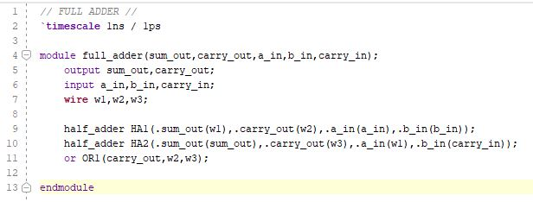
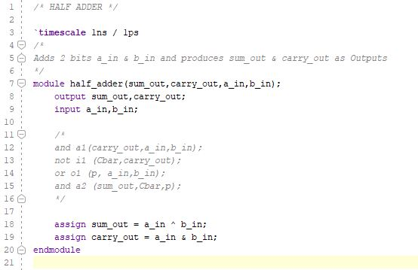
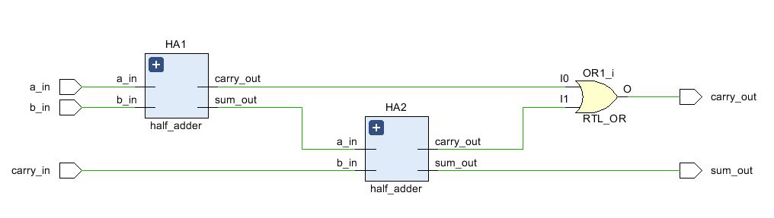
Code: Full Adder Design Source(.v)

Slide 8
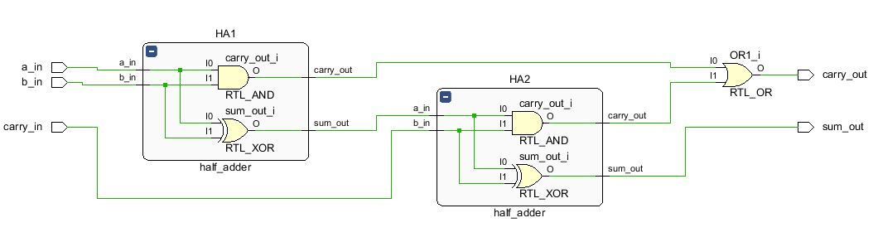
RTL Schematic (Elaborated Design)

Slide 9
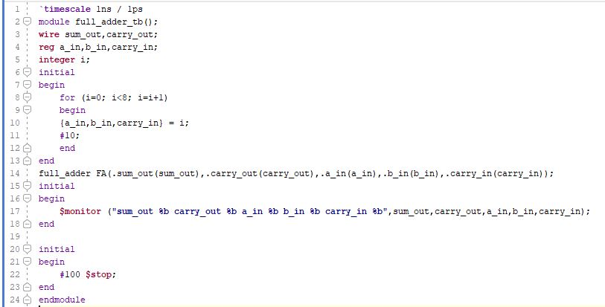
Code: Simulation Source(.v)

Slide 10
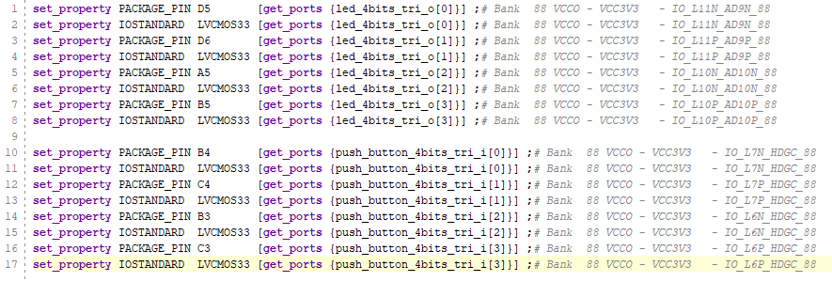
Code: Constraint Source (.xdc)

Slide 11
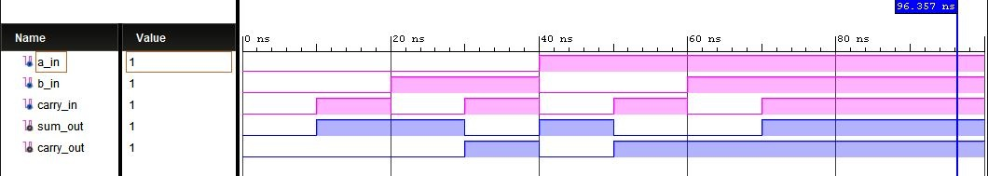
Simulation: Behavioral, Post – Synthesis Functional & Post - Implementation Functional

Slide 12
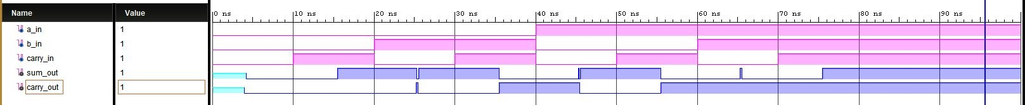
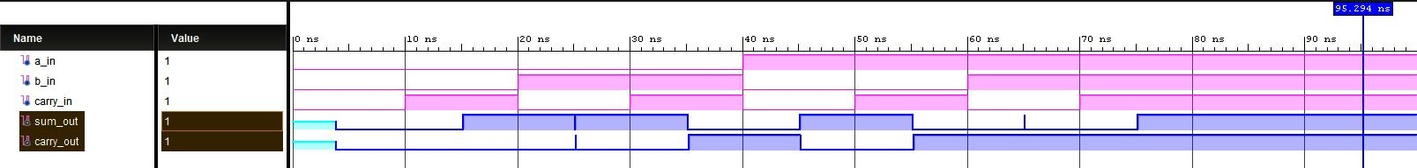
Simulation: Post – Synthesis Timing & Post - Implementation Timing

Slide 13
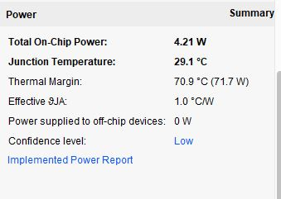
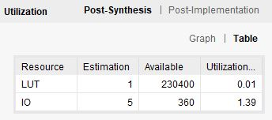
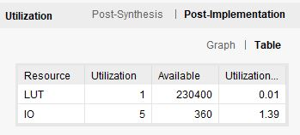
Reports: Hardware Utilization Post – Synthesis, Post – Implementation and Power

Slide 14
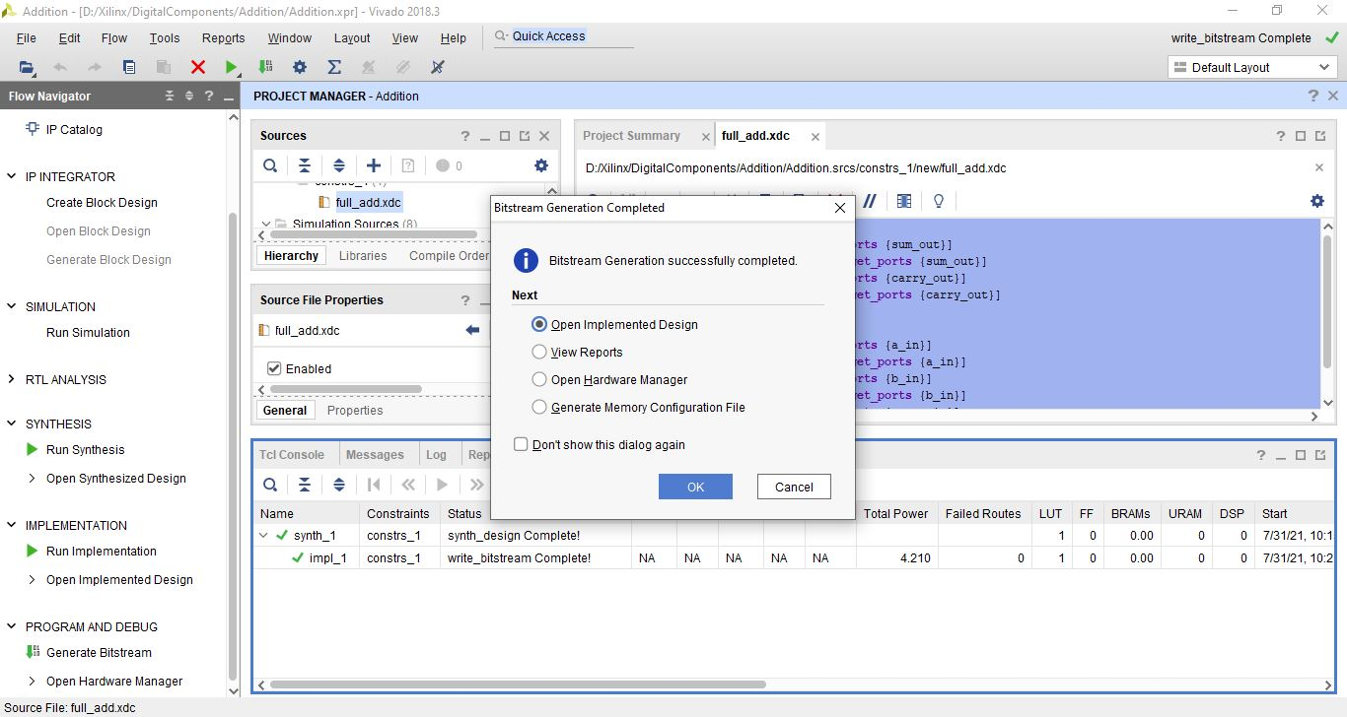
Bitstream Generation Completed

Slide 15
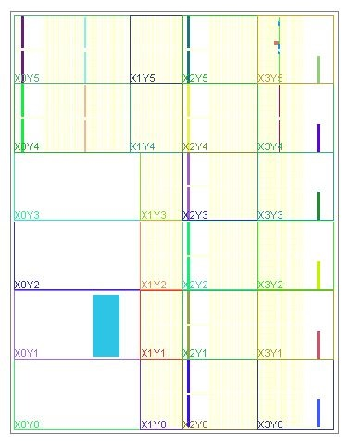
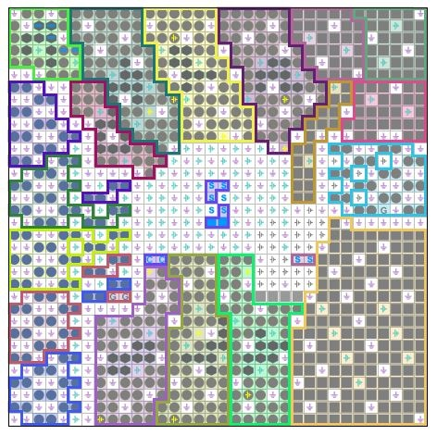
I/O Planning Layout
Device
Package

Slide 16
Thank You

Slide 17

QUERIES???

